Slide 1
CSE3100 (Software Development - IV)
Prepared by Mohammad Tanzilur Rahman
trrizvi07@gmail.com
+8801981995317

Slide 2
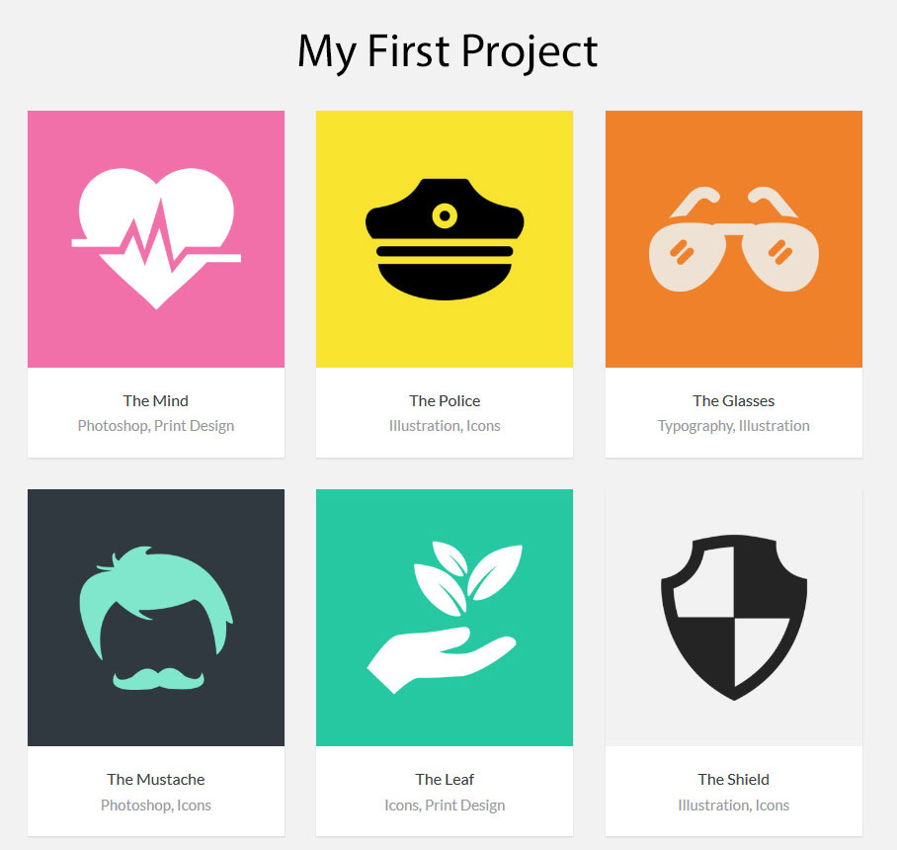
#8746ae
#a02829

Slide 3
Responsive Design
Add the responsive viewport meta tag to your <head>.
<meta name="viewport" content="width=device-width, initial-scale=1, shrink-to-fit=no">
Responsive breakpoint code
@media (max-width: 575px) { ... } @media (min-width: 576px) { ... } @media (min-width: 576px) and (max-width: 767px) { ... }

Slide 4
Responsive Breakpoint
Extra small devices (portrait phones, less than 576px)
Small devices (landscape phones, 576px and up)
Medium devices (tablets, 768px and up)
Large devices (desktops, 992px and up)
Extra large devices (large desktops, 1200px and up)

Slide 5
Bootstrap
Bootstrap is an open source toolkit for developing with HTML, CSS, and JS.
World's most popular front-end component library.
Have light but powerful plugin built on jQuery.

Slide 6
Bootstrap Source Code
Bootstrap Project Folder/
|---- css/
|---- bootstrap.min.css
|---- js/
|---- jquery.min.js
|---- bootstrap.min.js
|---- popper.min.js

Slide 7
Bootstrap Starter template
<head> <meta charset="utf-8"> <meta name="viewport" content="width=device-width, initial-scale=1, shrink-to-fit=no"> <link rel="stylesheet" href="css/bootstrap.min.css" /> <link rel="stylesheet" href="css/main.css" /> <title>Bootstrap</title> </head> <body>
<h1>Welcome</h1> <script src="js/jquery.min.js"></script> <script src="js/popper.min.js"></script> <script src="js/bootstrap.min.js"></script> </body>

Slide 8
Bootstrap (Containers)
Containers are the most basic layout element in Bootstrap and are required when using our default grid system.
<div class="container">
<!-- Content here -->
</div>

Slide 9
Bootstrap (Grid System)
Bootstrap’s grid system uses a series of containers, rows, and columns to layout and align content.
<div class="container">
<div class="row">
<div class="col-md-4"> One of three columns </div>
<div class="col-md-4"> One of three columns </div>
<div class="col-md-4"> One of three columns </div>
</div>
</div>

Slide 10
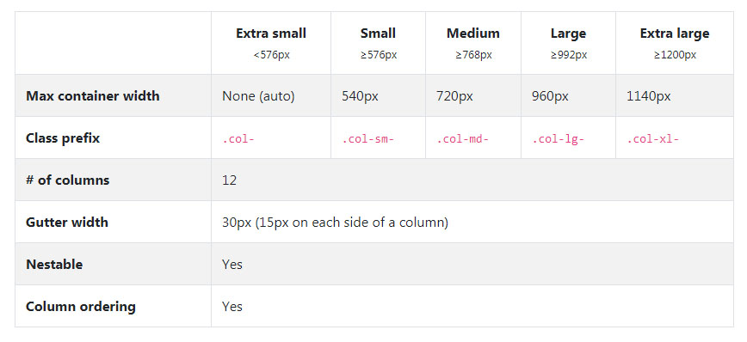
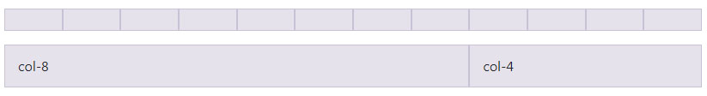
Bootstrap (Grid options)

Slide 11
Bootstrap Component
Alert <div class="alert alert-primary" role="alert"> A simple alert </div> alert-secondary | alert-success | alert-danger | alert-warning | alert-info |alert-light| alert-dark
<div class="alert alert-warning alert-dismissible fade show" role="alert"> <strong>Holy guacamole!</strong> You should check in on some of those fields below. <button type="button" class="close" data-dismiss="alert" aria-label="Close"> <span aria-hidden="true">&times;</span> </button> </div>

Slide 12
Bootstrap Component
Button <button type="button" class="btn btn-outline-primary">Primary</button> btn-lg | btn-sm | btn-block
Collapse <p> <a class="btn btn-primary" data-toggle="collapse" href="#collapseExample" role="button" aria-expanded="false" aria-controls="collapseExample"> Link with href </a> </p> <div class="collapse" id="collapseExample"> <div class="card card-body">[your_content]</div> </div>

Slide 13
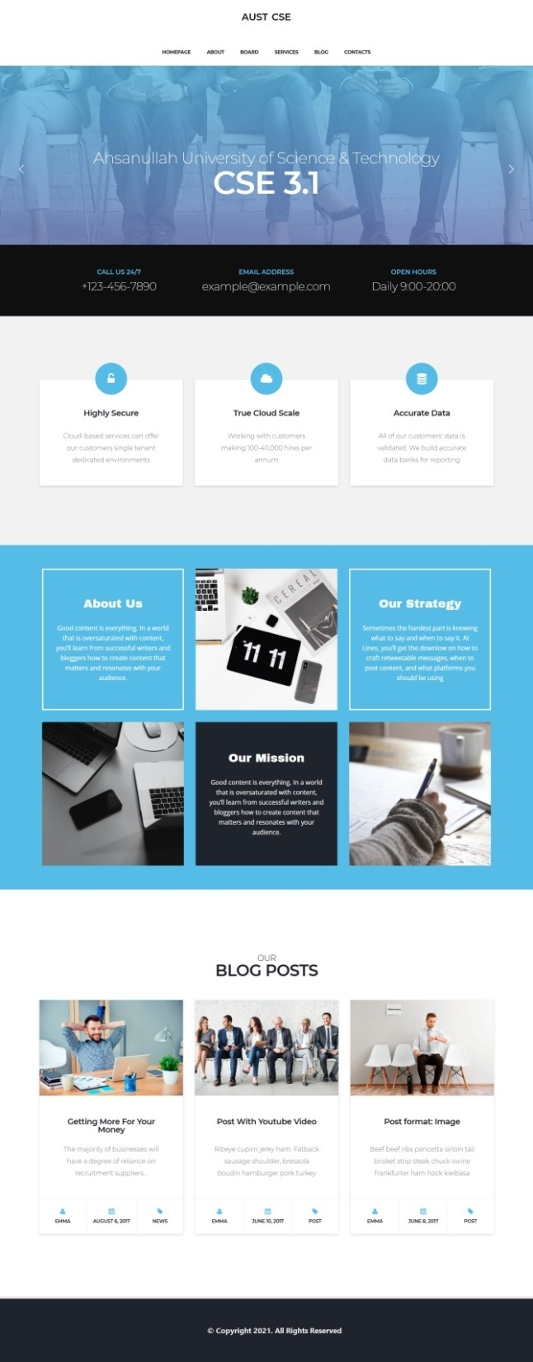
ASSIGNMENT #2

Slide 14
Final Project Requirement
Home Page
About Us Page
Team Page
Contact Page
Login & Registration Page
User Profile Page, Edit Option
Private Page
All Service/All Product Page
Service/Product Details Page

Slide 15
Thank You

